Slide 1

YAIP PROGRAM
Warren County 4-H Council is the administering organization

Slide 2

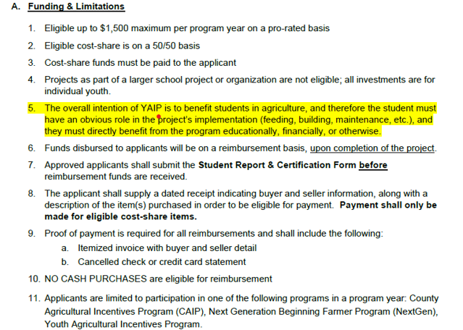
YAIP GUIDELINES

Slide 3

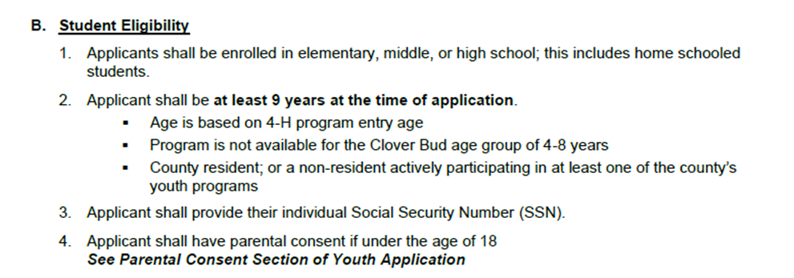
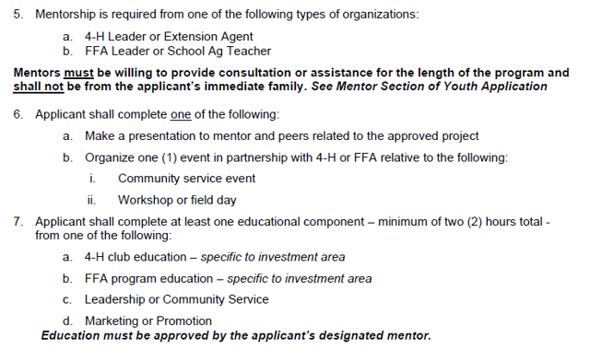
Student Eligibility

Slide 4
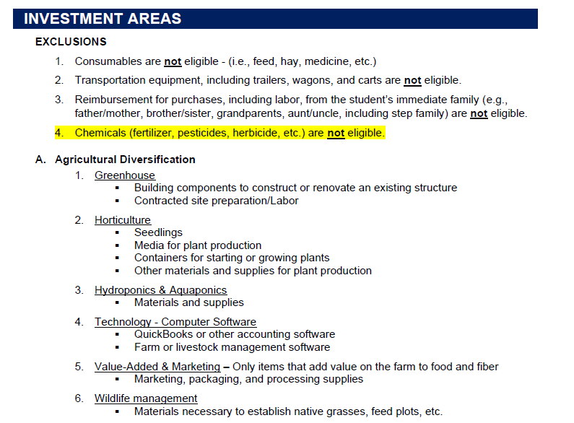

Slide 5
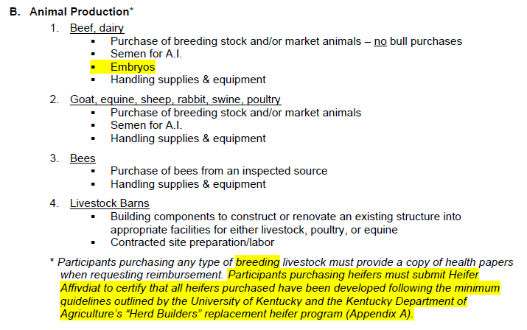

Slide 6

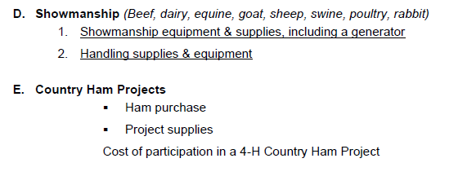

Slide 7

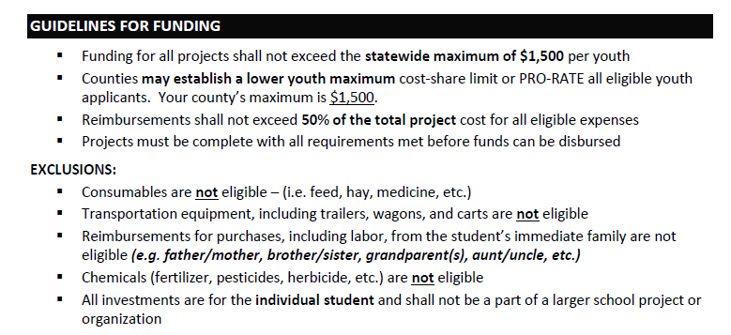

Slide 8
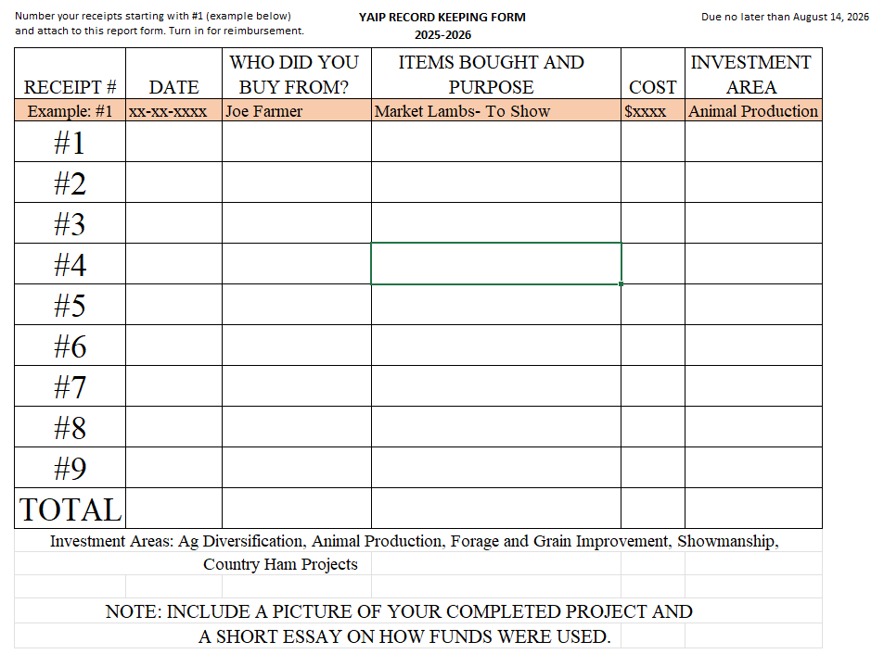
REIMBURSEMENT GUIDELINES

Slide 9
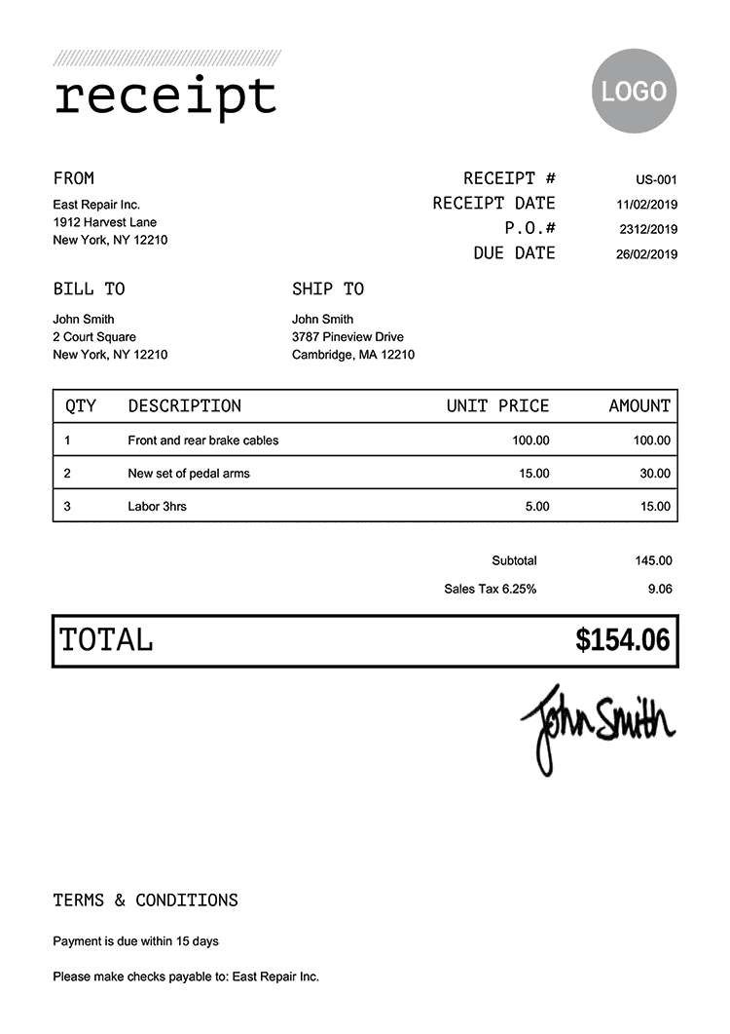

REIMBURSEMENT GUIDELINES

Slide 10
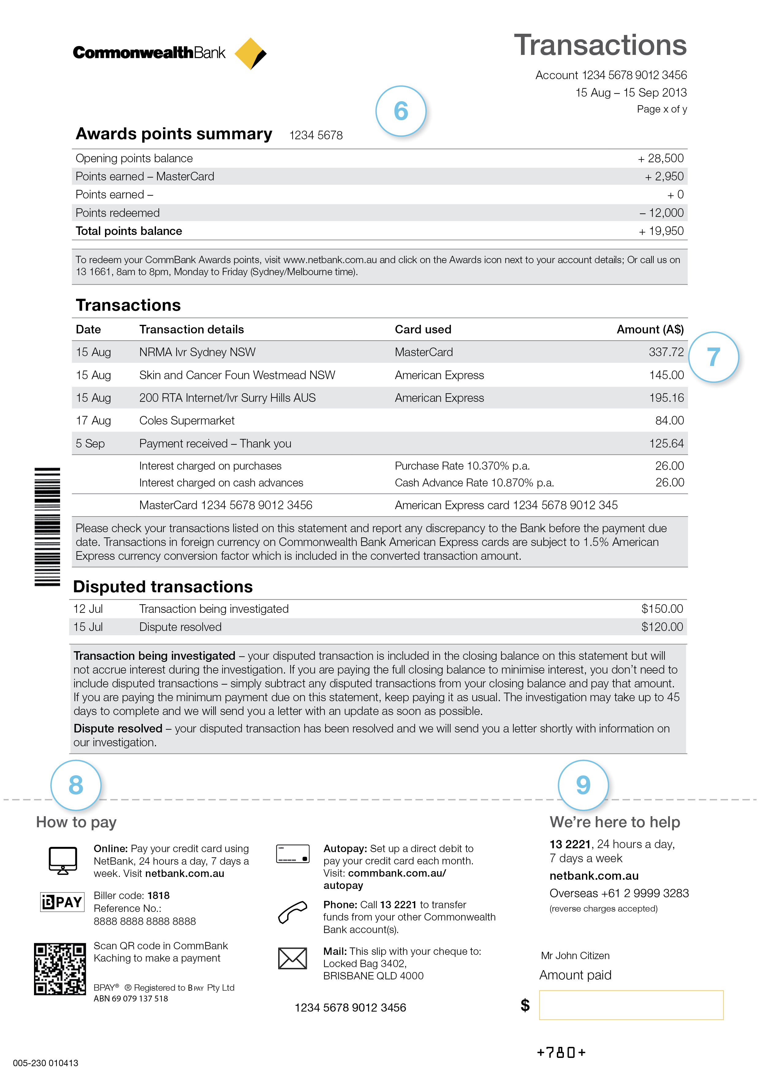
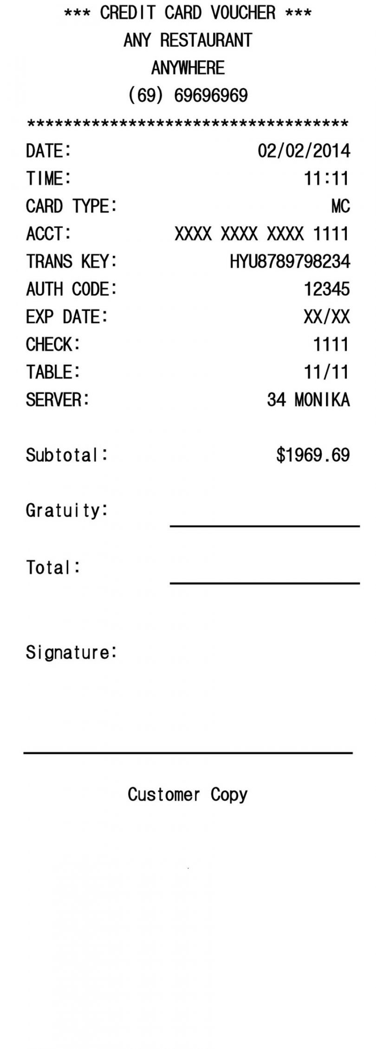
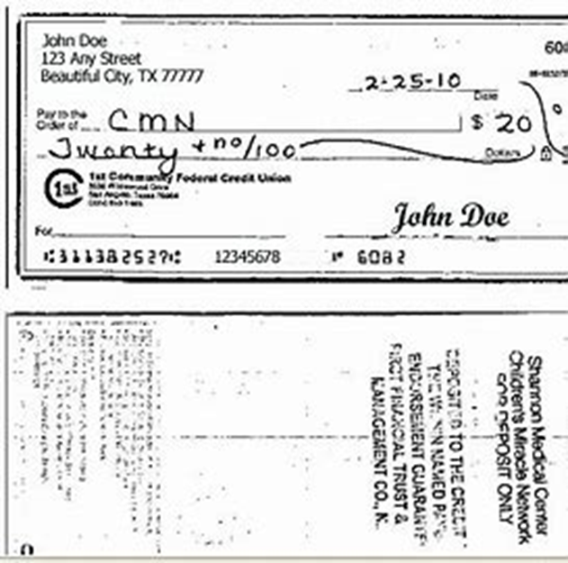
CANCELLED CHECK
DEBIT CARD RECEIPT
CREDIT CARD STATEMENT

Slide 11
Receipts MUST match transaction statement
For example: itemized invoice must match payment method (debit card or credit card statement or cancelled check).

Slide 12
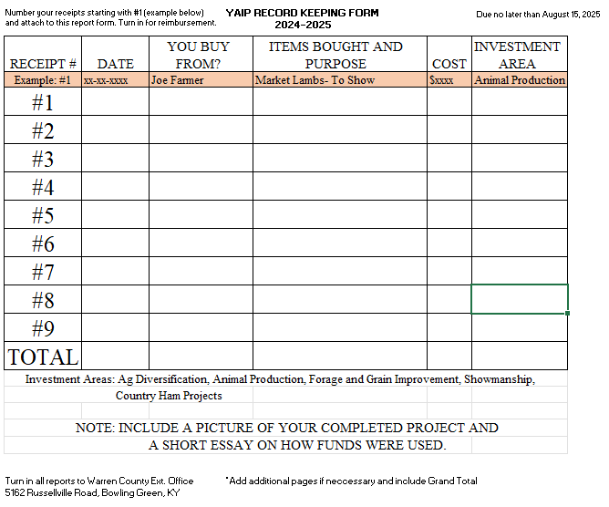
FINAL PAPERWORK DUE: AUGUST 14, 2026
Student Report and Certification
All receipts, invoices, proof of payment (numbered and labeled in record keeping form)
Include pictures of your project
Include a short essay on how the
funds were used
** Return to Warren County Extension Office
5162 Russellville Road, Bowling Green, KY

Slide 13
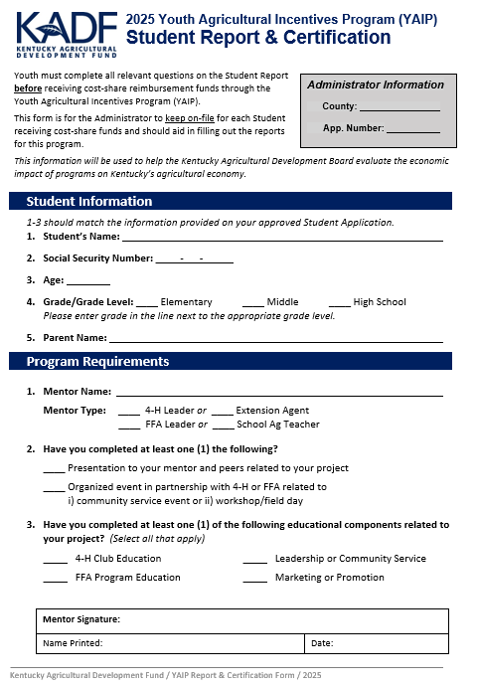
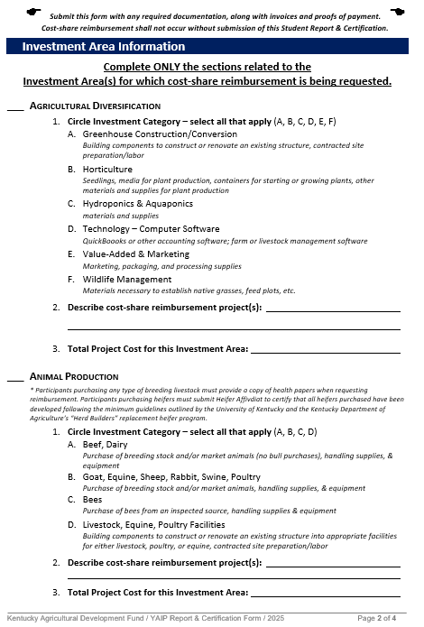
Student Report & Certification: Page 1 / 2 Form Due August 14, 2026

Slide 14
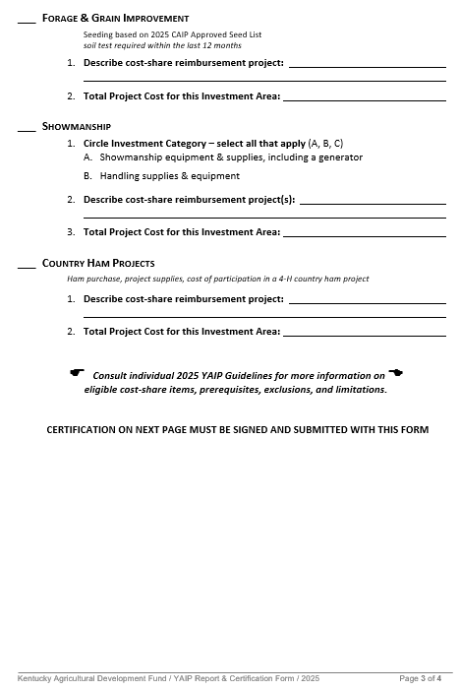
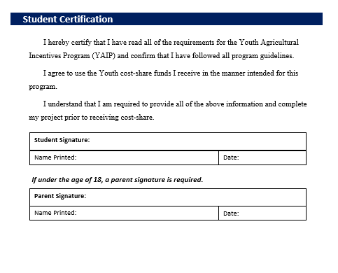
Student Report & Certification: Page 3 / 4 Form Due August 15, 2025

